Slide 1
Steady Rate of Heat Transfer through a medium of thermal conductivity
Team 6 Austin McGee Matthew Miller Christopher Nguyen Francis Ilde Nicdao

Slide 2
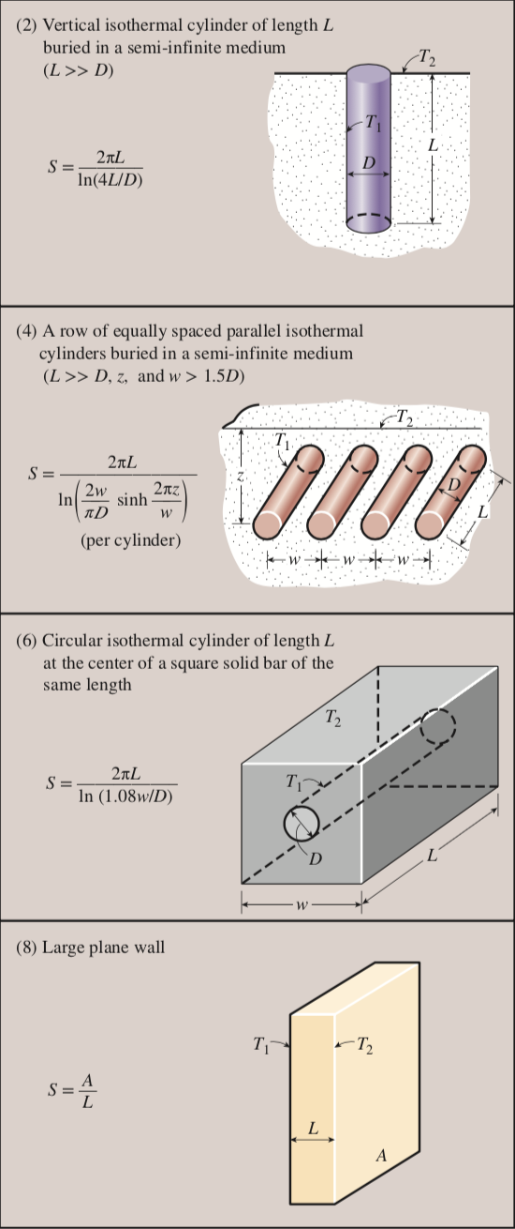
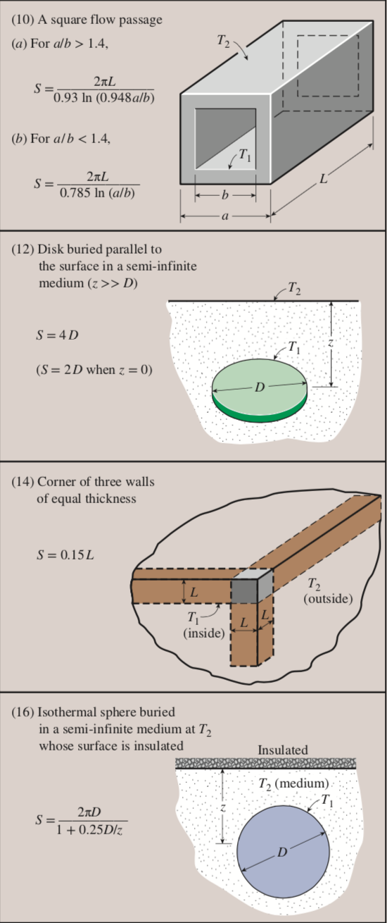

Introduction
Conduction shape factor provides an easy way of calculating total steady heat transfer rate between two isothermal surfaces.
Knowing the shape factor of a specific geometry we can now find the total steady heat transfer rate using:
Note: Heat transfer between both surfaces must be by conduction. This excludes when the surfaces are liquid or gas.

Slide 3
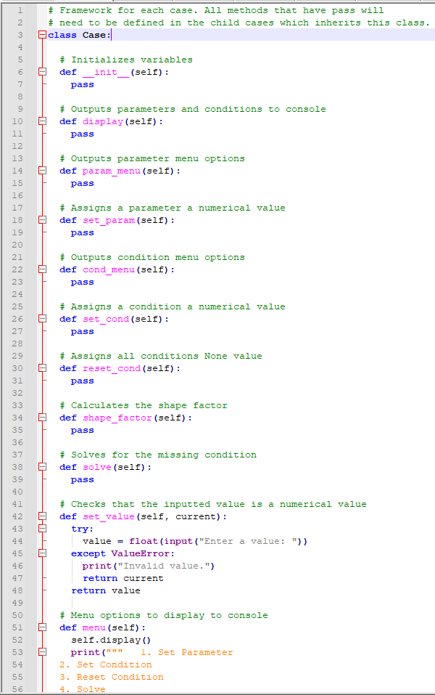
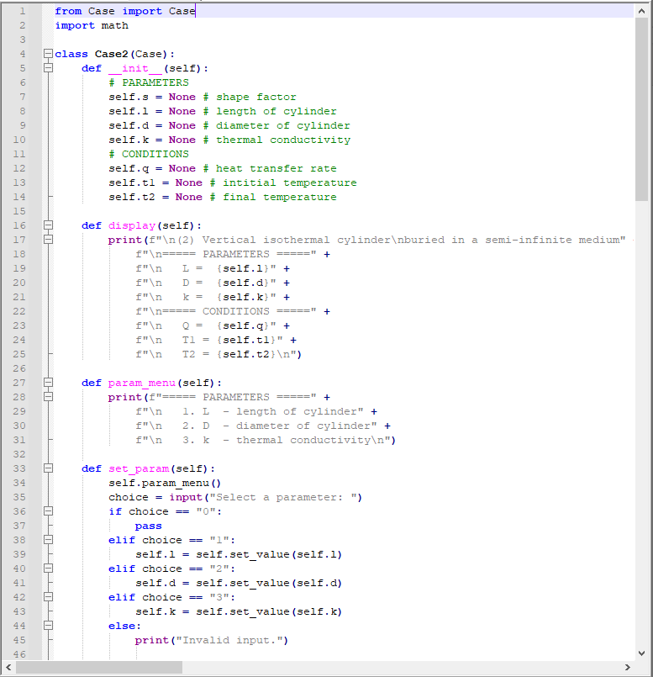
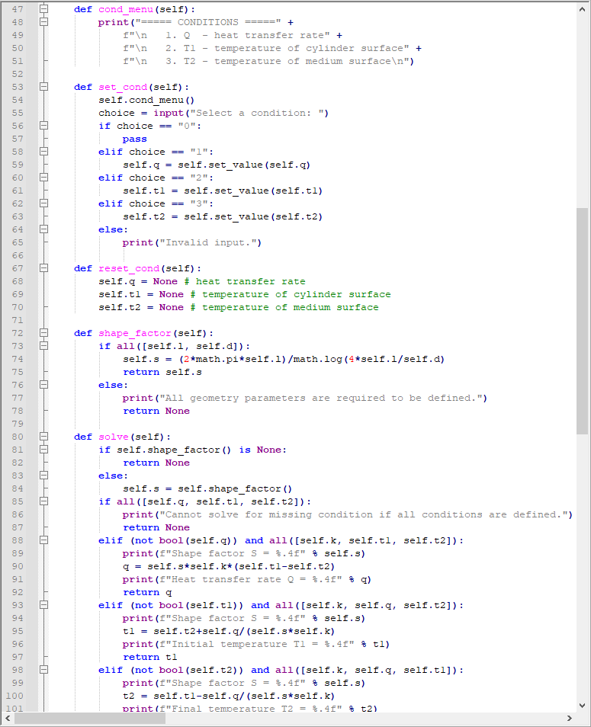
Code Documentation

Slide 4
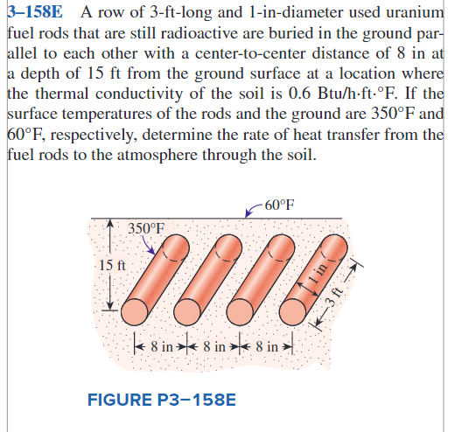
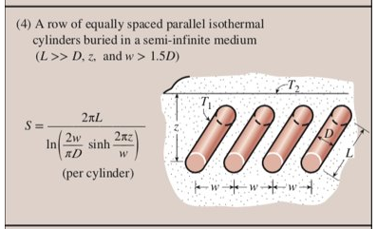
Heat Transfer Sample Problem
Case 4 from Table 3-7
We are going to use the code to solve this problem
Problem 3-158E in the book

Slide 5
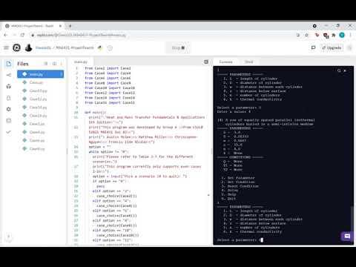
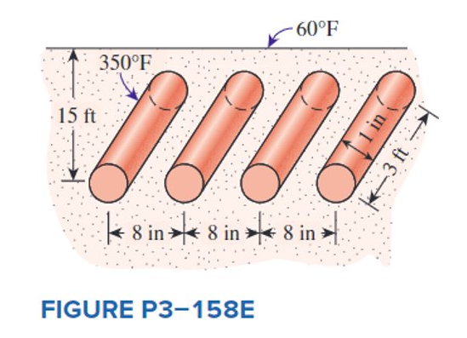
Heat Transfer Sample Problem

Slide 6
Discussion of Results and Recommendations
Program produces quick and accurate results
Generates shape factor per case
Limitations
Doesn't convert units
Cannot input fraction values
Cases written for even cases only (Team 5 has odd cases)
Recommendations
More user-friendly
Graphical User Interface
Input all parameters and conditions at the same time
More universal
Be able to convert units and output in desired units

Slide 7
Conclusion
Required conduction shape factor 'S = …' must be given for each case
Utilized Heat Transfer Equation between isothermal surfaces
Coded a user-controlled interface to calculate problems in Table 3-7

